Slide 1


Linear Regression in R
Efforts by:
Ananya Mathur 500091437
Insiya Rizvi 500094183
Akshit Gandotra 500091456

Slide 2

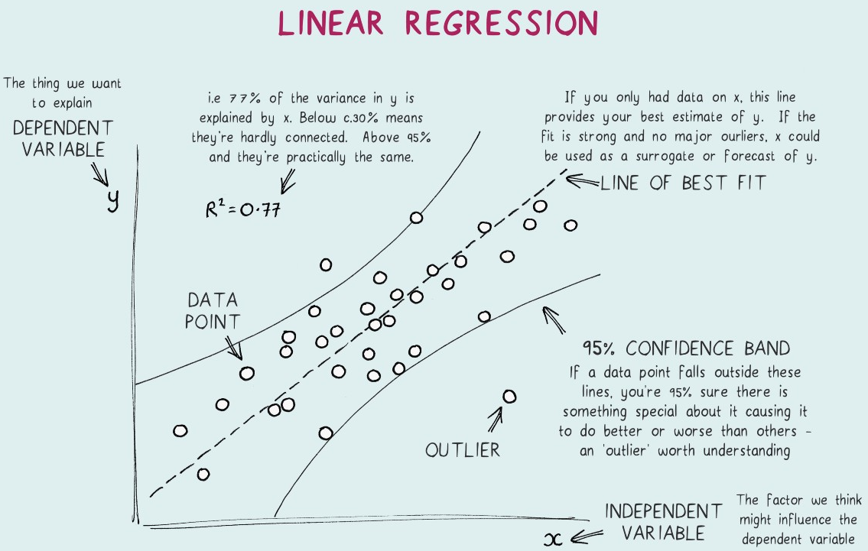
What is Linear Regression?
A linear regression measures the relationship between a response variable Y and a predictor variable X.
The variable you want to predict is called the dependent variable. The variable you are using to predict the other variable's value is called the independent variable.
This form of analysis estimates the coefficients of the linear equation, involving one or more independent variables that best predict the value of the dependent variable.
BEST FIT LINE:
Linear regression fits a straight line that minimizes the discrepancies between predicted and actual output values. Using a “least squares” method we can discover the best-fit line for a set of paired data. We then estimate the value of X (dependent variable) from Y (independent variable).

Slide 3
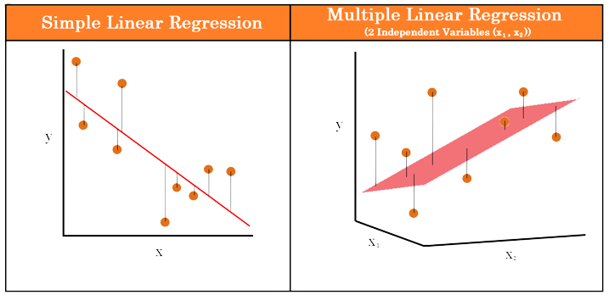
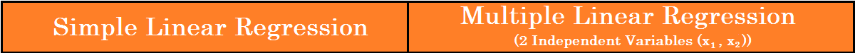
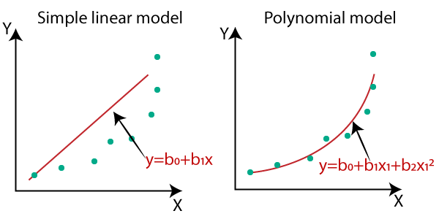
Types of Regressions
The term regression is used to indicate the estimation or prediction of the average value of one variable for a specified value of another variable. There are different types of regression analysis:
1. Linear Regression
It is a type of model where the relationship between an independent variable and a dependent variable is assumed to be linear. There are two kinds of Linear Regression Model:-
Simple Linear Regression: A linear regression model with one independent and one dependent variable.
Multiple Linear Regression: A linear regression model with more than one independent variable and one dependent variable.
2. Polynomial Regression
It is a type of Regression analysis that models the relationship of values of the Dependent variable “x” and Independent variables “y’’ as an nth degree polynomial.
If we apply a linear model on a non- linear dataset, loss function will increase, the error rate will be high, and accuracy will be decreased.

Slide 4
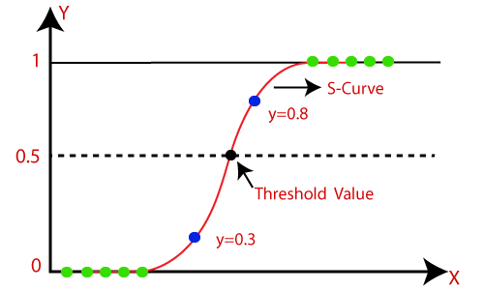
Types of Regressions (Continued)
3. Logistic Regression
Logistic Regression is a method that was used first in the field of Biology in the 20th century. Logistic regression predicts the output of a categorical dependent variable.
For example, the probability of certain events that are mutually exclusive, for example, happy/sad, normal/abnormal, or pass/fail. The value of probability strictly ranges between 0 and 1.
Logistic Regression is much similar to the Linear Regression except that how they are used. Linear Regression is used for solving Regression problems, whereas Logistic regression is used for solving the classification problems.
In Logistic regression, instead of fitting a regression line, we fit an "S" shaped logistic function, which predicts two maximum values (0 or 1).

Slide 5
Multivariable Linear Regression
It is quite similar to the simple linear regression model we have discussed previously, but with multiple independent variables contributing to the dependent variable and hence multiple coefficients to determine and complex computation due to the added variables.
For MLR, the dependent or target variable (Y) must be the continuous/real, but the predictor or independent variable may be of continuous or categorical form.
Each feature variable must model the linear relationship with the dependent variable.
MLR tries to fit a regression line through a multidimensional space of data-points.
When it comes to multivariable linear regression, we don't throw in all the independent variables at a time and start minimizing the error function. First, one should focus on selecting the best possible independent variables that contribute well to the dependent variable. For this, we go on and construct a correlation matrix for all the independent variables and the dependent variable from the observed data.
The correlation value gives us an idea about which variable is significant and by what factor.

Slide 6

Problem Statement
Companies have to spend huge amounts on marketing in order to boost sales and create brand awareness. There are various forms for marketing, and we need to find out which medium is the most effective way to boost sales.
We will use the marketing data set, which contains the advertising budgets (in hundred-thousands of US dollars) for three media (Facebook, YouTube and newspapers) of a fictional company and sales data for that company.
The dataset is included in the datarium package.

Slide 7
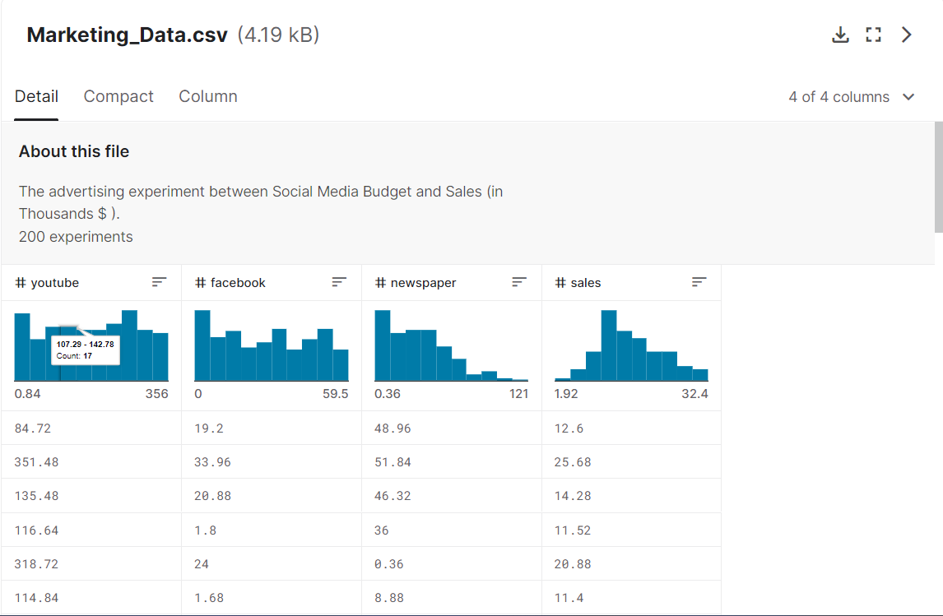
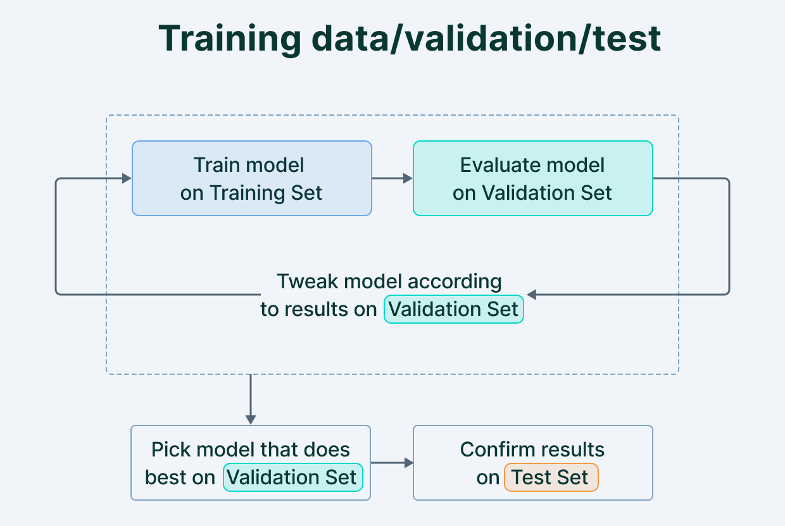
Dataset
This dataset contains 200 cases. The regression model has been applied to a cleaned up and trimmed subset of 171 cases. A 80:20 split has been used for training and testing.

Slide 8
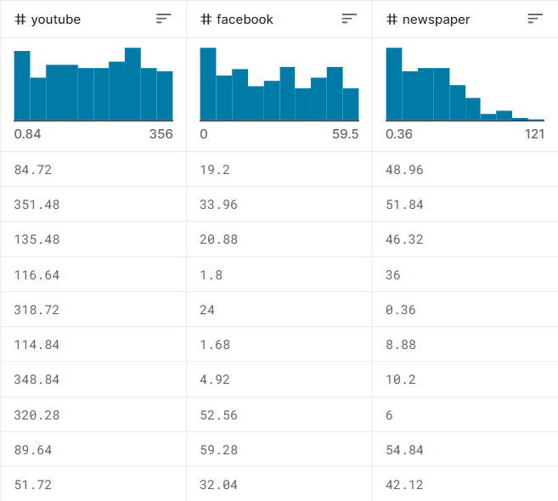
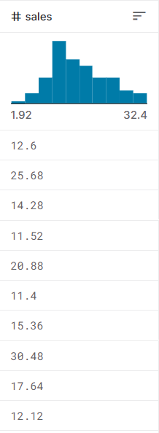
Variables Used
We are using three independent variables, namely “Facebook”, “YouTube”, and “Newspaper”. These independent variables are directly related to the dependent variable, “Sales”.
x1 = YouTube
x2 = Facebook
x3 = Newspaper
y = Sales

Slide 9

Findings & Accuracy

Slide 10
Conclusion

